Slide 1
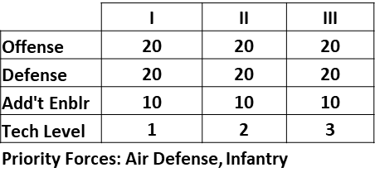
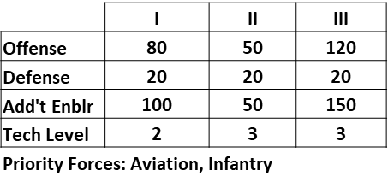
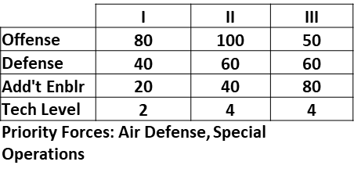
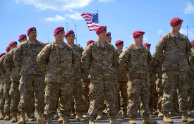
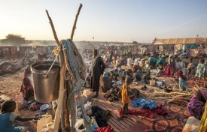
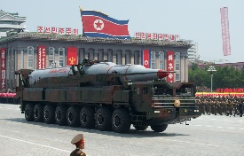
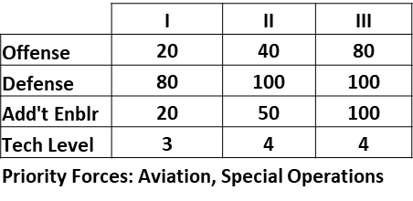
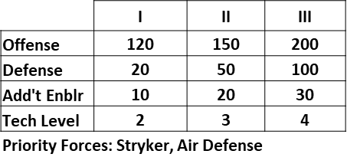
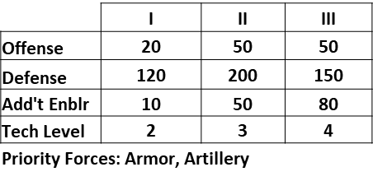
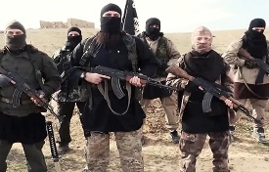
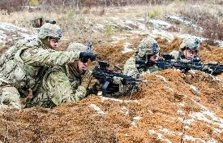
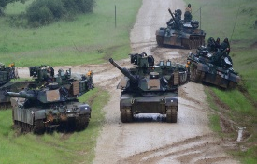
MOST LIKELY TO OCCUR
36% (Roll 2-5,10)
19% (Roll 7, 12)
14% (Roll 6)
Steady State
Humanitarian Crisis
Rogue State
LEAST LIKELY TO OCCUR
14% (Roll 8)
11% (Roll 9)
5% (Roll 11)
ISIS 2.0
Defensive Campaign
(vs Peer Competitor)
Offensive Campaign
(vs Peer Competitor)

Slide 2
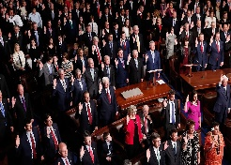
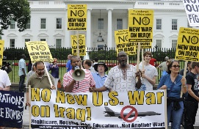
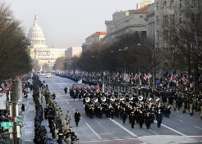

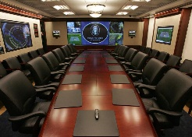
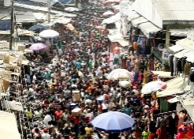
MOST LIKELY TO OCCUR
36% (Roll 2-5,10)
19% (Roll 7, 12)
14% (Roll 6)
Congressional Interests
Unfriendly Administration
Friendly Administration
Roll 2d6 to select force type and roll 1d6 for quantity (2d6 if round 3). Must procure forces ≥ quantity rolled if you don't already have them.
Decrease this round’s budget
by 10%
Increase this round’s budget
by 10%
Filling the pork barrel…
Sequestration? Again?
Friends in high places
LEAST LIKELY TO OCCUR
14% (Roll 8)
11% (Roll 9)
5% (Roll 11)
Cyber Attack
White House Priority
Uprising
Before rolling for R&D and force upgrades, roll 1d6 to determine reduction to force upgrade rolls this round
Roll 2d6 to select crisis using crisis board. Must exceed the priority force requirements by at least 2 units of either type.
Roll 1d6 before crisis outcome roll. If ≥ 5, increase crisis outcome roll by 2. If 2 ≤, decrease crisis outcome roll by 2.
Those cheaters…
Someone’s got their attention
Will they love us or hate us?

Slide 3

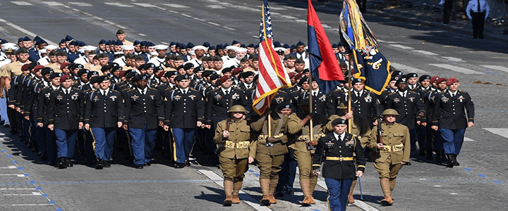
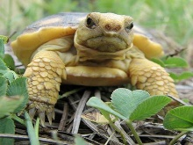
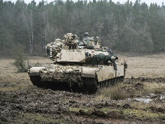
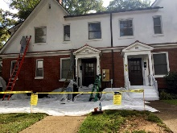
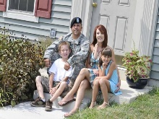
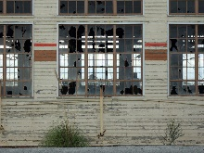
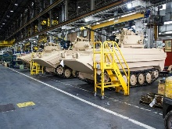
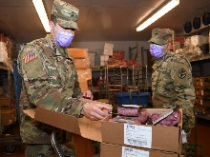
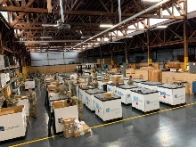
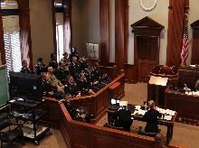
MOST LIKELY TO OCCUR
36% (Roll 2-5,10)
19% (Roll 7, 12)
14% (Roll 6)
Public Opinion
Training Environment
Health and Quality of Life
Roll 1d6 for (effect) on MILPERS
Roll 1d6 for (effect) on O&M
Roll 1d6 for (effect) on
MILPERS & MILCON
1 (-2), 2-3 (-1)
Anti-Military Sentiment
4-5 (+1), 6 (+2)
Pro-Military Sentiment
1 (-2),2-3 (-1)
Restrictive
4-5 (+1), 6(+2)
Permissive
1 (-2),2-3 (-1)
Low
4-5 (+1), 6(+2)
High
Do they love us or hate us?
Train like we fight?
Happy and healthy or not?
LEAST LIKELY TO OCCUR
14% (Roll 8)
11% (Roll 9)
5% (Roll 11)
Infrastructure
Supply Chain
Corruption and Scandals
Roll 1d6 for (effect) on MILCON
Roll 1d6 for (effect) on
Procurement & O&M
Roll 1d6 for effect and type
Effect
1-2: -1
3-4: -2
5-6: -3
Type
1: MILCON
2: MILPERS
3: Procurement
4: O&M
5: All
6: No effect
1 (-2), 2-3 (-1)
Inadequate performance
4-5 (+1), 6 (+2)
Successful Performance
1 (-2),2-3 (-1)
Inadequate Performance
4-5 (+1), 6(+2)
Successful Performance
Keeping the lights on…
Are you the weakest link?
The Army’s bad apples…

